Slide 1
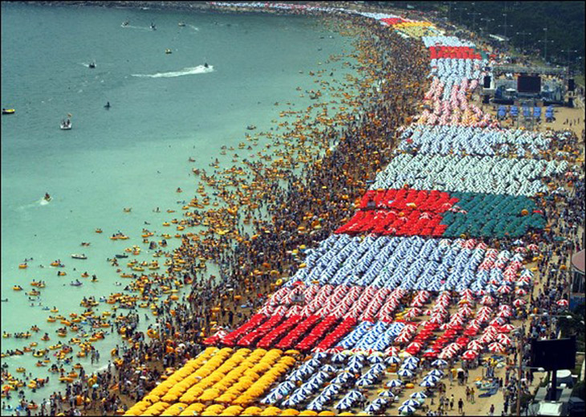
ABUNDANCE

Slide 2
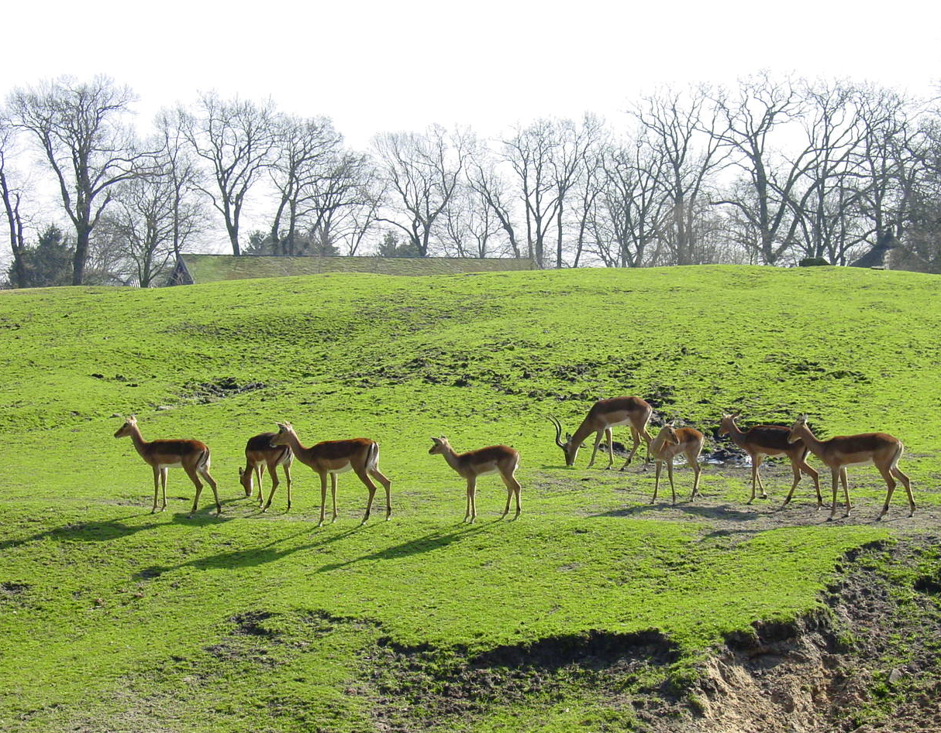
What determines the size of a population?
Output of individuals
Mortality
Migration
Input of individuals
Natality
Immigration

Slide 3
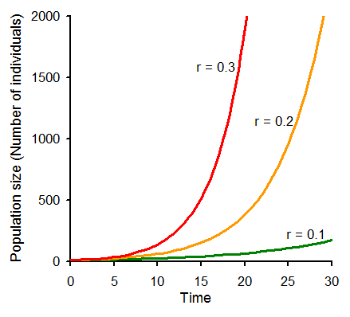
No controls on population growth
Density-independent growth
Population growth rate (r) = natality + immigration - mortality - migration
Population size (N) _{(t+1)} = N_{(t)} + N_{(t)} * r
Time | r = 0.1 | r = 0.2 | r = 0.3
0 | 10 | 10 | 10
5 | 16.1 | 24.88 | 37.13
10 | 25.93 | 61.91 | 137.8
15 | 41.77 | 154.1 | 511.8
20 | 67.27 | 383.4 | 1900
25 | 108.3 | 954.0 | 7056
30 | 174.5 | 2373 | 26199

Slide 4
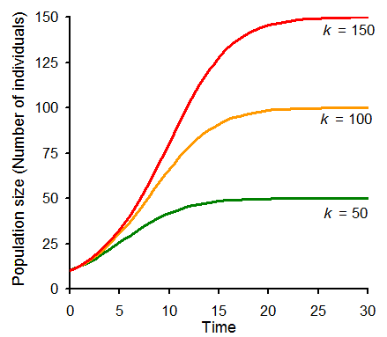
Controls on population size: carrying capacity
Density-dependent growth or logistic model or Lotka–Volterra model
Population size (N) _{(t+1)} = N_{(t)} + N_{(t)} * r
Density dependence ratio
Density-independent growth
r = 0.3
Time | K=50 | K=100 | K=150
0 | 10 | 10 | 10
5 | 25.54 | 30.48 | 32.47
10 | 41.81 | 65.97 | 80.72
15 | 48.31 | 91 | 127.8
20 | 49.70 | 98.31 | 145.5
25 | 49.94 | 99.7 | 149.2
30 | 49.99 | 99.9 | 149.9
r = 0.3
Terms:
N = population size
r = population growth
K = carrying capacity

Slide 5
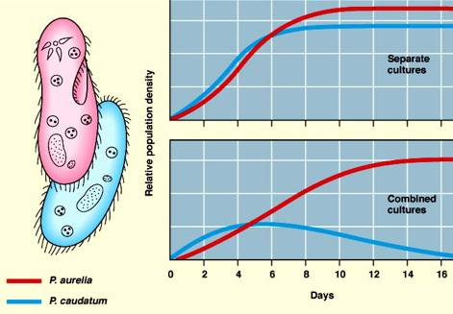
Controls on population size: competition
Density-dependent growth with competition or competitive Lotka–Volterra models
Density dependent growth:
αAB represents the effect species B has on the population of species A
Competition-density dependent growth:
Principle of competitive exclusion
Harding, Science 1960

Slide 6
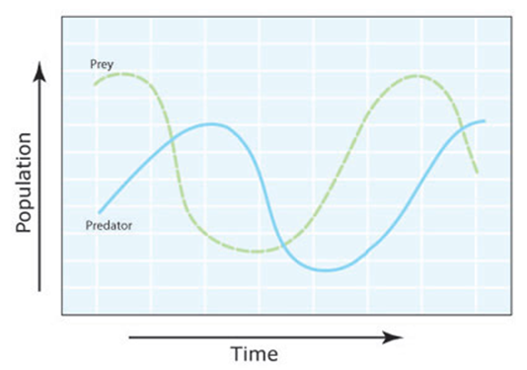
Controls on population size: Predation
Prey population size:
β predation rate coefficient
Predator population size:
λ reproduction rate of predators per 1 prey eaten

Slide 7
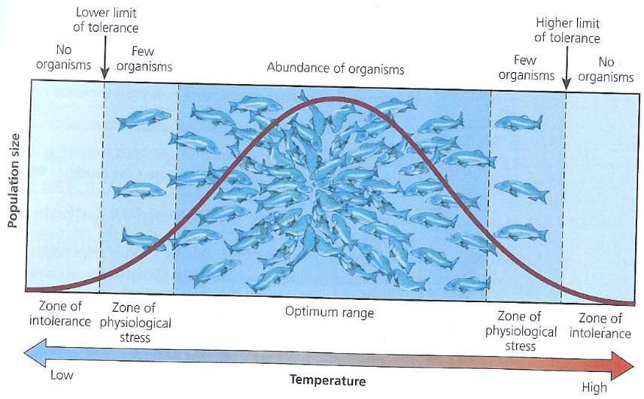
Controls on population size: density independent controls
Density-independent factors include environmental tolerances, food or nutrient limitation, pollutants in the environment, and climate extremes, including seasonal cycles such as monsoons

Slide 8
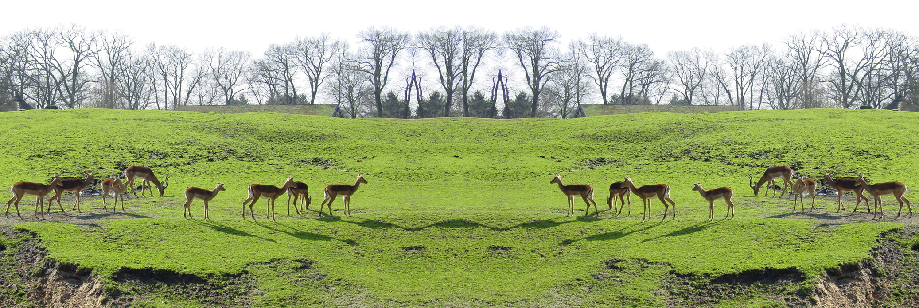
Controls on population size: Dispersal and habitat quality
Metapopulation dynamics: ensemble of inhabited patches interconnected by dispersing propagules
Input of individuals
Immigration
Natality
Output of individuals
Migration
Mortality

Slide 9

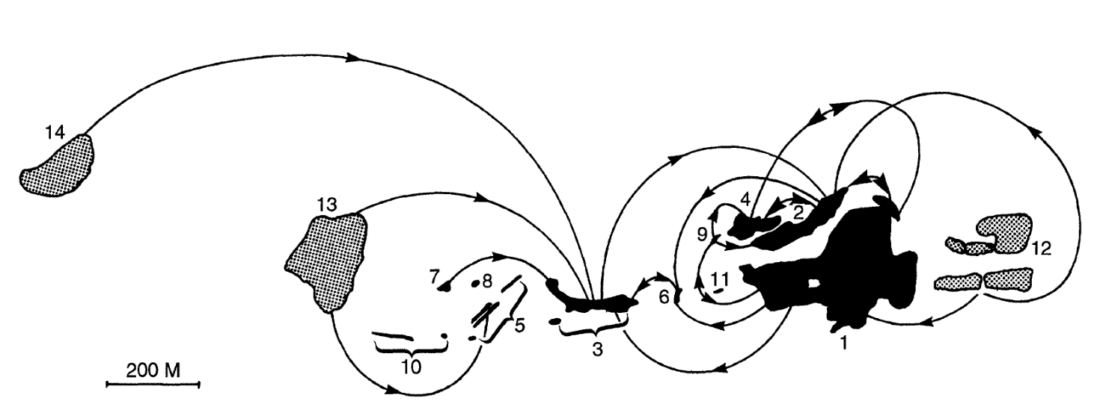
Important attributes for the maintenance of a metapopulation:
Colonized patches of a butterfly species (Hill et al, J. Anim. Ecol. 1996)
Patch isolation
Patch quality
Patch size

Slide 10
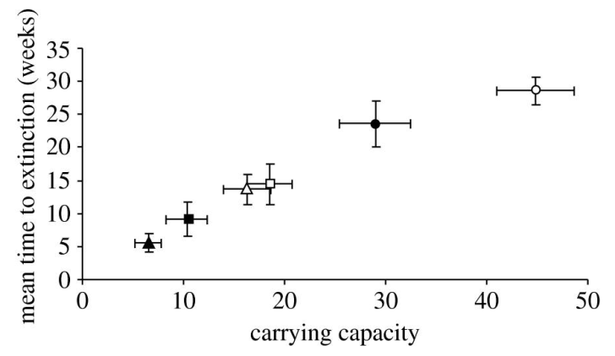
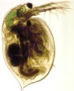
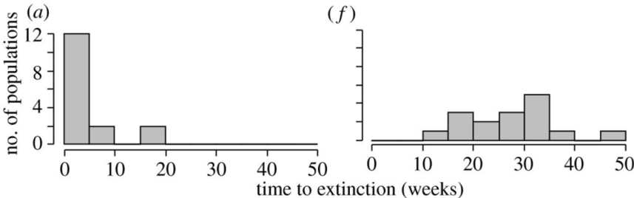

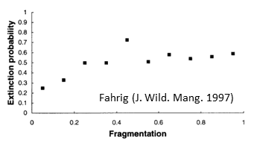
Rules of thumb about habitat in metapopulations
Effects on population size
The larger a patch the larger the populations
Direct effect on carrying capacity
Griffen & Drake (Proc. Biol. Sci. 2008)
The larger a patch the larger the rate of immigration
Low food/small patch
high food/large patch
Effect of patch size and quality
The smaller the isolation the larger the input of new individuals
Griffen & Drake (Proc. Biol. Sci. 2008)
Effect of patch isolation
The better the quality of habitat the larger the populations and resilience of their individuals

Slide 11
In summary
Ecological Interactions
Habitat characteristics
Predation,
Competition,
Mutualism, etc
Patch size, isolation and quality
Environmental constraints, nutrients, pollutants, etc
Input of individuals
Immigration
Natality
Output of individuals
Migration
Mortality

Slide 12
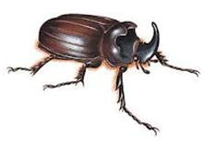
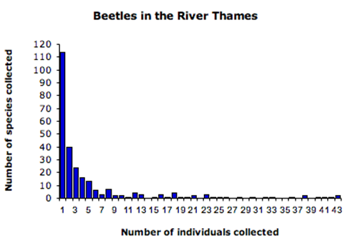
Patterns in species abundance
Species abundance distributions
In most natural communities, most species are represented by one or few individuals
“Most species are rare”, Andrewartha & Birch, Book 1954
Magurran, Book 2004

Slide 13
Species abundance distributions: why skewed?
Niche partitioning
A
B
C
D
E
MacArthur , PNAS 1957: “stick fragment”
Resource
Sequential subdivision of a resource causes progressively smaller populations

Slide 14
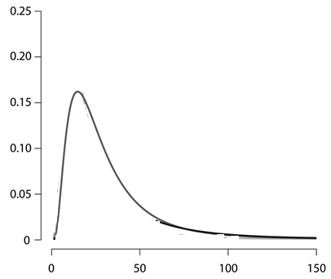
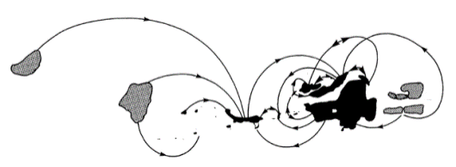
Species abundance distributions: why skewed?
Neutral Theory
Assumptions: 1. Local communities are saturated with individuals
2. Dispersal kernel distributions are left-skew
So… who is more likely to occupy the niche of a species that goes locally extinct?
Relative abundance of propagules
The offspring of a species that is locally common...so
common species will become more common and rare species rarer
Distance

Slide 15
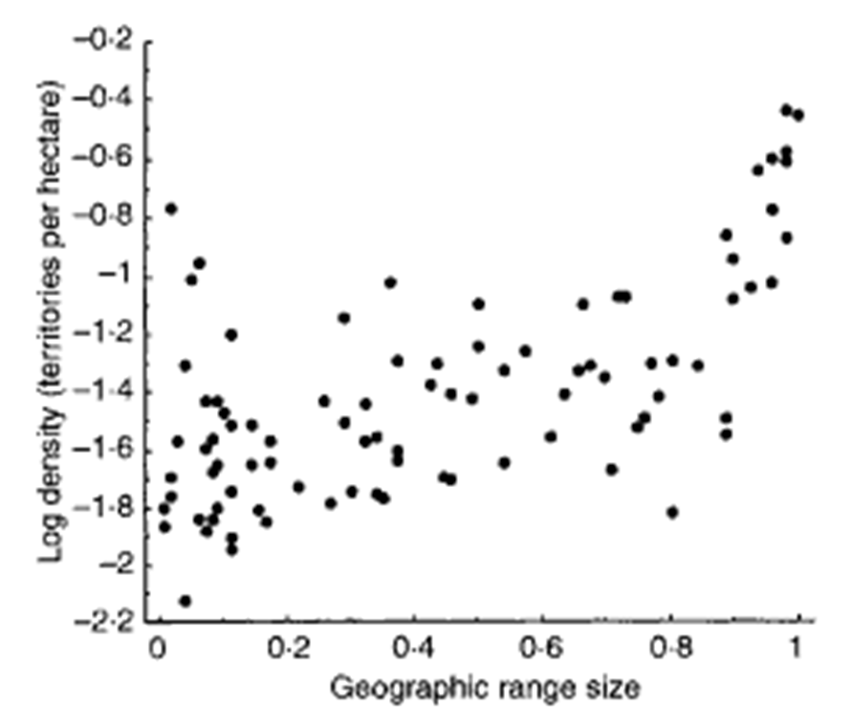
Patterns in species abundance
Abundance – range size relationship
Broadly distributed species tend to have larger local densities
EXPLANATIONS:
Niche of species:
1. Abundant species use more space so larger range size follows as a by-product of abundance.
2. The same niche characteristics that make a species locally abundant can make it broadly distributed.
Neutral theory:
1. Locally abundant species have higher probability to disperse way from occupied sites increasing range size.
2. Highly dispersing species can maintain high local abundances over large areas.
Gaston et al. J. An. Ecol. 1997

Slide 16
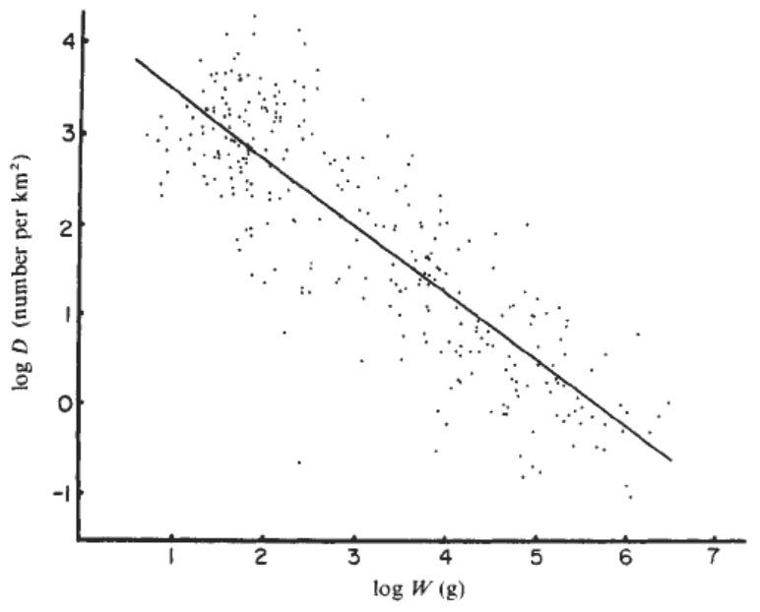



Patterns in species abundance
Abundance – body size relationship
Species with large bodies are less abundant than species with small bodies
Why?: energetic equivalence rule
Sunlight
Abundance
BIOMASS
Damuth, Nature 1981
Body size

Slide 17
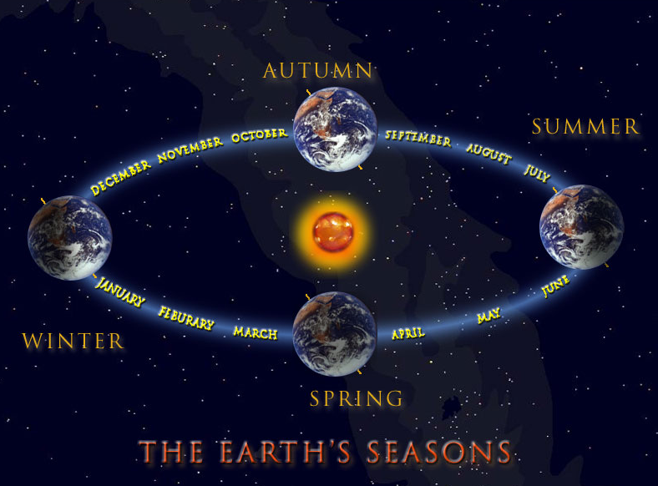
Temperature effect on abundance
We know body size is larger at high-colder latitudes, then the inverse relationship between body size and abundance suggest..what?
That abundances are larger in the tropics than at high latitudes

Slide 18
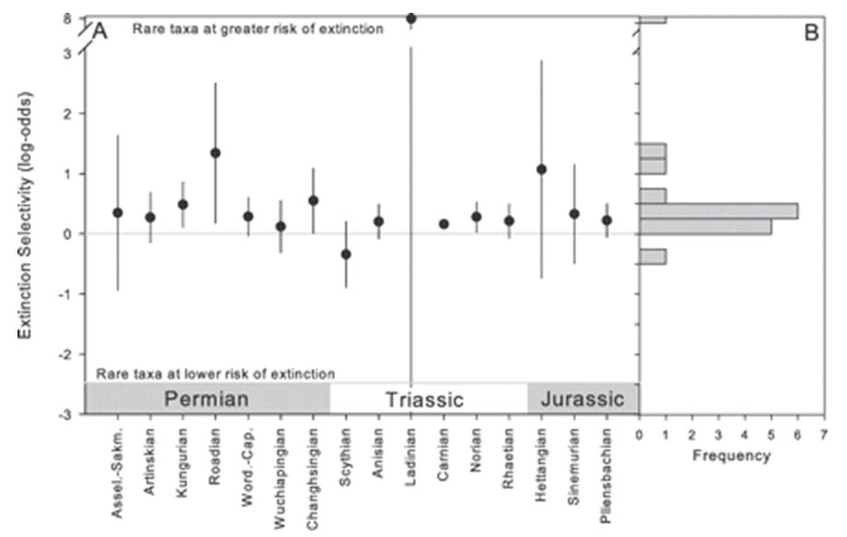
Why is abundance important?
Abundance is related to extinction risk
Relation between abundance and extinction
Payne et al., Paleobiology 2011
Notes:
Association between genus occurrence frequency and survival into the subsequent stage. The association is expressed as the common logarithm (i.e., base 10) of the odds ratio. Positive values indicate preferential survival of abundant genera; negative values indicate preferential survival of rare genera

Slide 19
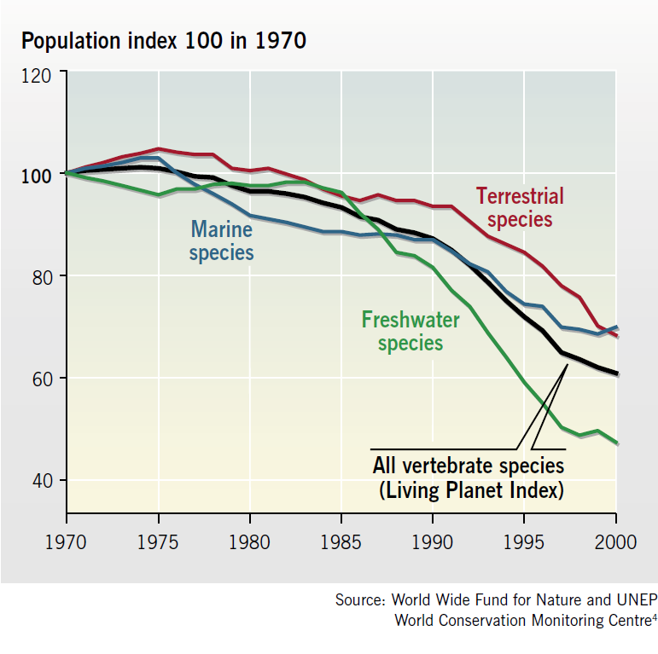
Why is abundance important?
Some ~3000 monitored populations have declined about 40% between 1970 and 2000
- Inland water species declined by 50%
- Marine and terrestrial species declined by 30%
Worrisome signs about extinction risk

Slide 20
In summary
Ecological factors and density independent factors (tolerances to environmental factors, habitat quality, etc)
Natality: recruitment
Mortality
Population size
Immigration
Emigration
Size and isolation of habitats
Patterns: Causes:
1. Most species are rare.
2. The larger the abundance the broader the geographical distribution.
3. The larger the abundance the larger the body size.
Niche and neutral theory
Resource use
Notes:
Third point is an error for student to pick up.

